Slide 1
Learning Fused Pixel and Feature-based View Reconstructions for Light Fields
CVPR submission ID 9007

Slide 2
Interpolation

Slide 3
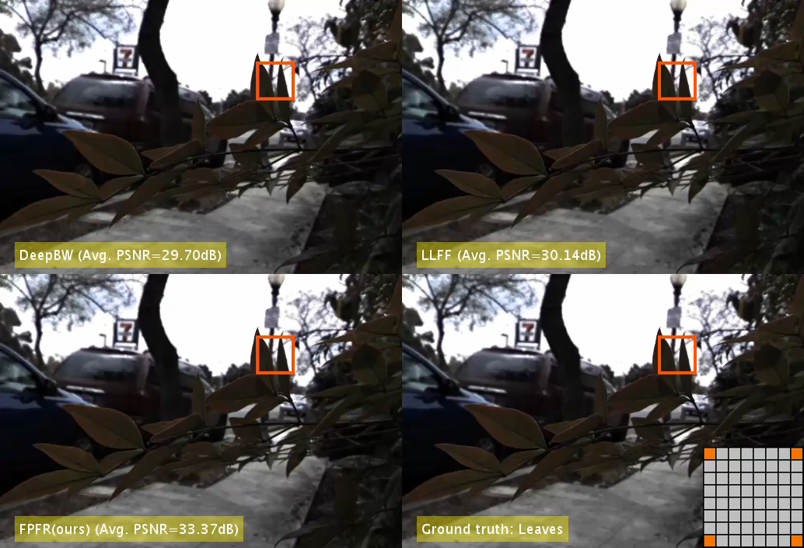

Slide 4
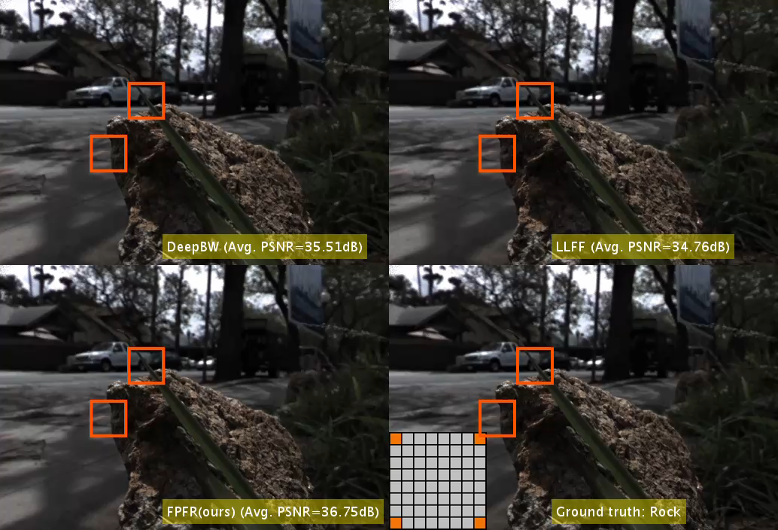

Slide 5
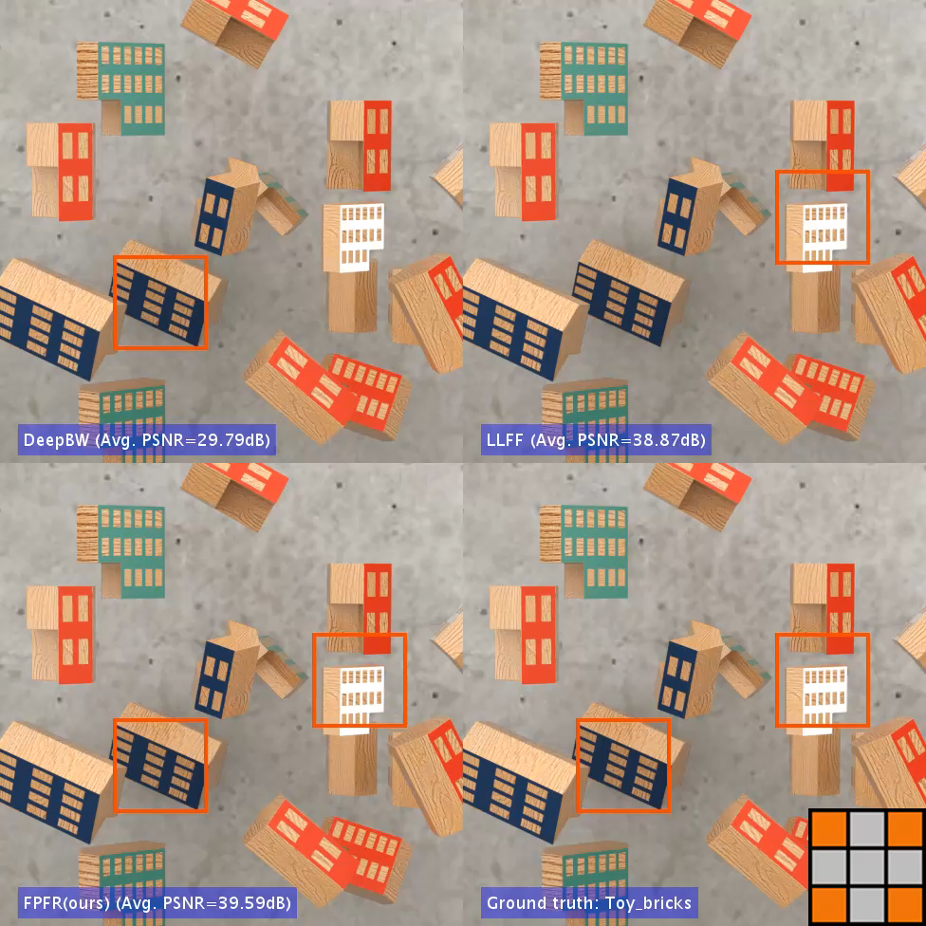

Slide 6
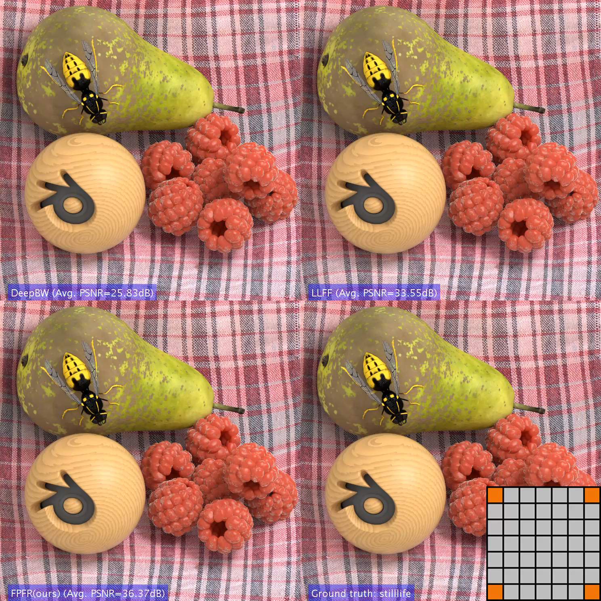

Slide 7
Extrapolation

Slide 8
